Slide 1
Introduction to http apis

Slide 2

About the speaker
Bryce Jech
Web Developer at the Oklahoma State University Foundation
Developing web and network applications for 5 years
Previously worked for a WISP as a web and network programmer (Python)
Slack display name: @pyguy
Github: https://github.com/brycejech
LinkedIn: https://www.linkedin.com/in/brycejech/
Twitter: @brycejech
Hobbies: Foosball, longboarding, gardening, cooking

Slide 3
Topics for today
What is an API?
Introduction to RESTful architecture
Introduction to JSON-RPC
Introduction to GraphQL
$.ajax
Let’s build a tool with the GitHub API

Slide 4
What is an api?
API is an acronym for Application Programming Interface
An API is a means through which we allow third party software to interact with our application
APIs allow us to encapsulate implementation details of a piece of software behind an interface, only exposing the parts of the application that we want other software to be able to use
This allows the users of our API to focus on what the application does; not, necessarily, how it does it
Among other benefits, it also allows us to make changes to the way our application works (provided it still exposes the same interface) without breaking third party software that may use it

Slide 5
RESTful vs JSON-RPC
You may hear the term REST, or RESTful, API used a lot. Oftentimes, developers may describe their APIs as RESTful, which should mean that the API conforms to the principles of the REST Application Architecture. Sometimes, however, what they are actually referring to can be more aptly described as Remote Procedure Calls (RPCs) over HTTP, typically using JSON or XML as a data format
A brief introduction to both REST and RPC style APIs will be covered. When making a decision on which architecture is most suited to your application, you can apply the following questions
Is your application primarily based on actions?
Use RPC
Is your application primarily based on data/collections with Create, Read, Update, Delete (CRUD) functionality?
Use REST
Both REST and JSON-RPC (as well as GraphQL) will be covered today. Just keep in mind that both REST and JSON-RPC are application architectures designed to solve particular architectural problems. Neither is, necessarily, better than the other, they are just different. By the end of the day, you will be able to tell the difference between each

Slide 6
What is RESTful architecture?
REST stands for Representational State Transfer
RESTful APIs are particularly well suited to data driven applications with CRUD (Create, Read, Update, Delete) functionality
REST is a particular type of application architecture built on six constraints
Uniform Interface, Stateless, Cacheable, Client-Server, Layered System, Code On-Demand

Slide 7
Uniform interface REST Constraint #1
This constraint defines the interface between clients and servers. It decouples the application and enables each part to work and evolve independently
It has 4 primary principles
Resource Based
Resources are identified by URIs, e.g. /lists/3284/items/1
Resources are conceptually separate from the representations sent to the client

Slide 8
Hello, I’d like to hear a restful api joke
CLIENT: GET server/api/v1/joke
SERVER: What do you call a stolen Tesla?
CLIENT: GET server/api/v1/punchline
SERVER: …punchline to what?
How this conversation should have gone
CLIENT: GET server/api/v2/jokes/1
SERVER: What do you call a stolen Tesla?
CLIENT: GET server/api/v2/jokes/1/punchline
SERVER: An Edison 🤣

Slide 9
Uniform interface REST Constraint #1 - Continued
Manipulate Resources via Representations
A client that has a representation of a particular resource should have everything it needs to modify that resource on the server (assuming it has permission to do so)
Self-descriptive Messages
Each message should include enough information to process that message. This can include the MIME type (JSON, XML, HTML, etc), information on whether the response can be cached and for how long, and many many others
Hypermedia as the Engine of Application State (HATEOS)
Clients deliver state to the server via the request body, HTTP headers, querystring parameters, and the request URI
Servers deliver state to clients via body contents, status codes, and response headers (hypermedia)
As necessary, server responses should also include links to related resources. Related resources can be used to describe relationships, provide links to the next/previous result set when using pagination, etc

Slide 10
Stateless REST Constraint #2
All of the state required to process a request should be contained in the request itself. This state can be transferred as part of the URI, request body or headers, or querystring
Statelessness allows for much better scalability, as the server does not have to maintain or communicate state
When not using sessions to store state, it also makes load balancing simpler and more performant because load balancers do not need to worry about which server a client should be directed to

Slide 11
Cacheable REST Constraint #3
Responses should explicitly or implicitly define themselves as cacheable. This allows clients to avoid some trips to the server and further improves scalability and performance
Client-server REST Constraint #4
Clients are not concerned with data storage, which makes client code more portable
Servers are not concerned with views or user state, which makes them more scalable and simpler
Servers and clients can be updated and replaced independently, as long as they expose the same interface

Slide 12
Layered System REST Constraint #5
Clients should not be able to tell if they are connected directly to the server or to an intermediary server
Intermediary servers can handle things like shared response caches, load balancing, and the enforcement of security policies, leading to further improved performance and scalability
Code On-demand REST Constraint #6
Servers can extend client functionality by sending executable code to the client. These could be JavaScript libraries, Java applets, etc

Slide 13

REST APIs in the wild
The GitHub API v3 is an excellent example of a RESTful API
It has fantastic documentation available at https://developer.github.com/v3/

Slide 14
What is an rpc-api?
RPC stands for Remote Procedure Call
Today we will only be covering the JSON-RPC specification
Other popular RPCs include XML-RPC and SOAP
RPCs are primarily focused on methods that perform calculations, do actions, manipulate data, and the like
The easiest way of thinking about RPCs is that they are essentially just functions that we are calling on a remote server.

Slide 15
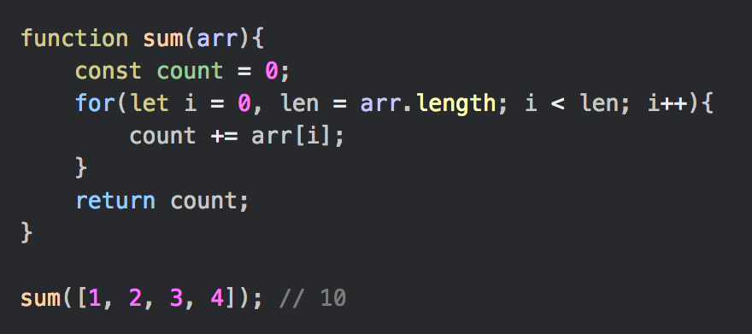
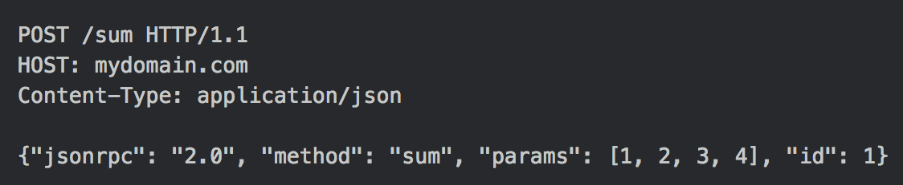
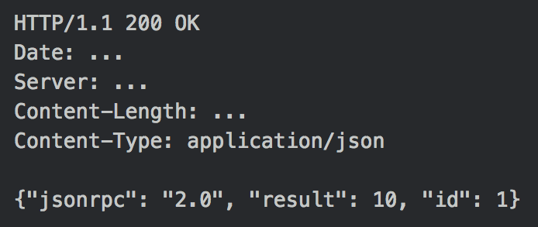
Consider the following JavaScript code:
Here is what the calling of the `sum` function above might look like as an HTTP request to a JSON-RPC API:
…and the server response we are expecting:

Slide 16
JSON-RPC Response Object
Member | Purpose | Constraints
jsonrpc | Identify the version of the spec being used | Must be a string
result | Relay results to the client | Required on success, must not be present on error
error | Relay error information to the client | Required on error, must not be present on success. Must be an object
id | Correlate requests and responses | Required unless not provided by the client (request is considered a notification)

Slide 17
A couple of things to note about the JSON-RPC spec
Each request and response must have a jsonrpc member that indicates the version of the spec being used, 2.0 in this case
If the client is interested in the response, an id field must be supplied (otherwise, the request is considered to be a notification), the server must respond with the same id number provided by the client so that requests and responses can be correlated
Procedure calls may be batched by supplying an array of request objects, rather than a single request object. This is where the id field becomes important
JSON-RPC 2.0 Specification

Slide 18
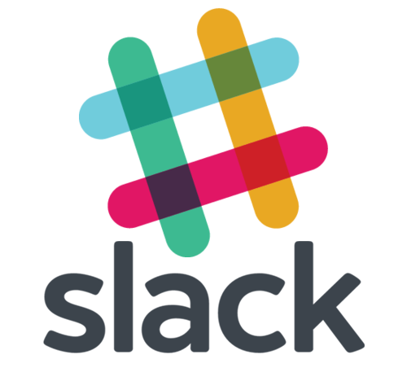
JSON-RPCs IN THE WILD
The Slack Web API is an RPC-like API
It’s not completely true to the JSON-RPC spec, but it is a platform we are all familiar with
Documentation available at https://api.slack.com/web

Slide 19
WHAT IS GraphQL?
Despite the implications from its name, GraphQL is not a query language for graph databases. Rather, it is a query language and runtime for building APIs
GraphQL enables declarative data fetching in which the client can request exactly the data it needs from the API.
Rather than having multiple endpoints that each expose fixed data structures, a GraphQL API exposes only a single endpoint and responds with precisely the data requested by the client. Pretty neat!
GraphQL itself is not a database, rather it is a query language for APIs, not databases, and is thus database agnostic and can be used in any context where APIs are used.

Slide 20
Where is graphql useful?
GraphQL is especially useful for limiting the number of round trips to the API by the client and also limiting the overall amount of network traffic. Only the requested data is being transferred over the network, and all at once, rather than clients having to query multiple API endpoints to build up a full picture of the data they need
This not only has the benefit of providing greater application performance, due to the lower amount of network requests, but can also tremendously simplify our application code, especially in situations where requests are dependent on one another

Slide 21
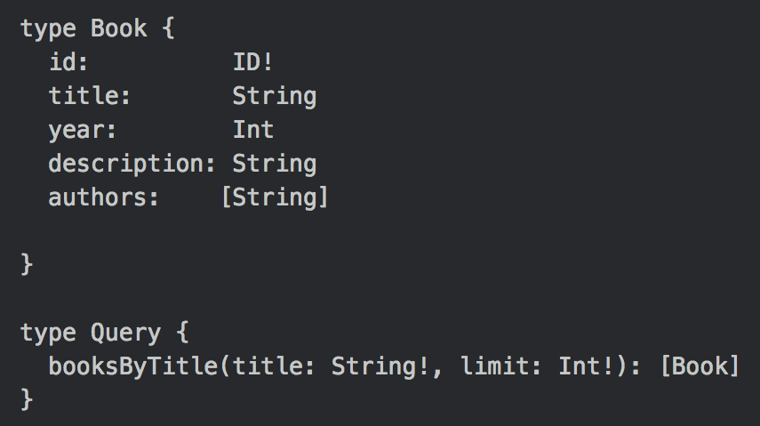
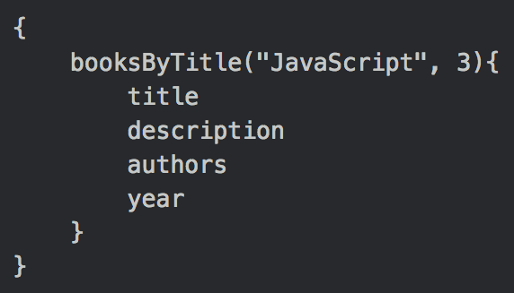
Graphql requests
Consider the following GraphQL Schema:
In order to use the booksByTitle query that we created, we would send a request with a body that looks like this:
In this schema, we've defined a Book type and a Query type. The Query type will be our entry point into the GraphQL service.

Slide 22
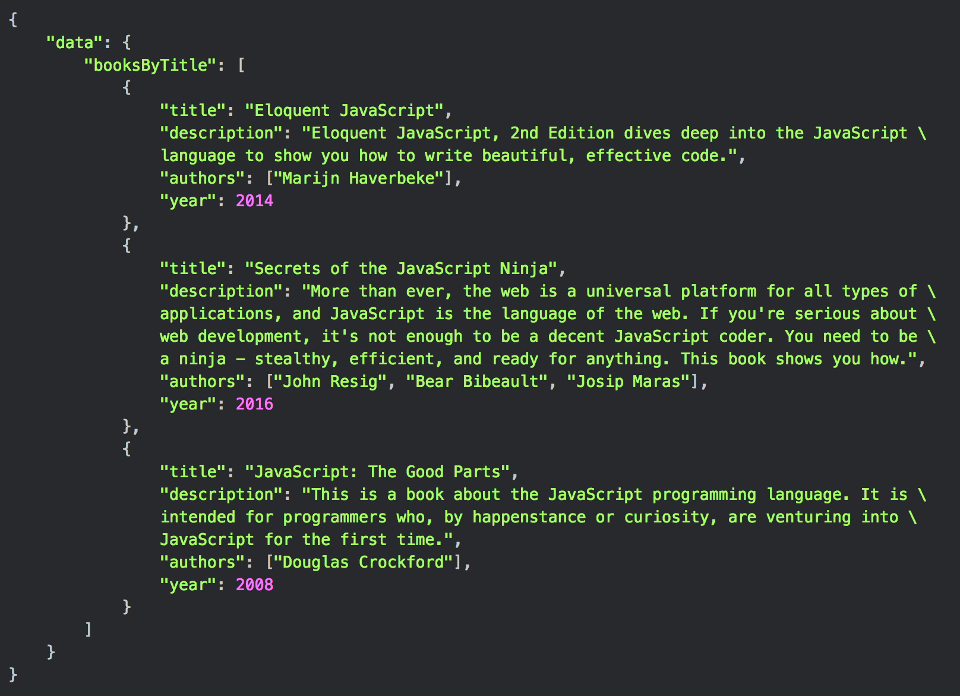
GraphQL responses
In the previous example, we pass the parameters "JavaScript" and 3 to the booksByTitle query along with the properties we want returned.
Here is a response that we may expect from the API:
As you can see, the API returned only the data we requested although it may have much more information availble. In this particular case, we requested all the data available as declared by the schema, but in a real-world example this is usually not the case.
GraphQL queries and schemas can get much more complex than this. This example is used simply to illustrate the syntax and return data structure.
Note: Line breaks have been added here so the entire response would fit. In reality, these line breaks would not be there.

Slide 23
Benefits of graphql
Schema / Type System
GraphQL requires schema built with a strict type system. This allows developers to know exactly what types of data are available, and the format they are in
Request Only Needed Data
Since queries can precisely define the data needed at query time, all data required to render a view can be requested in a single request. This reduces the total number of API requests and, thusly, application latency
Wraps Existing Data Services
GraphQL can work with any database or data layer. This allows a single GraphQL service to load data from multiple sources in a single request

Slide 24


Graphql in the wild
The Facebook Graph API is a GraphQL API
https://developers.facebook.com/docs/graph-api/
GitHub v4 API is also GraphQL
https://developer.github.com/v4/

Slide 25
What benefits does an http api provide?
Regardless of whether your API is RESTful or RPC based, it still provides a lot of benefits
Loose coupling between client and server
Client software is extremely resilient to changes on the server
Uses less resources (compared to similar technologies such as SOAP)
Performance, scalability
Cachable (reads)
Permits different data formats (JSON, XML)
JSON has been the de facto standard for some time; it parses faster than XML (less overhead) and is generally a better fit for data transfer.

Slide 26
Using apis
In order to use HTTP APIs from the browser, we need a way to make an HTTP request. Several methods exist, such as jQuery's ajax method, the native fetch API, and native XMLHTTPRequests. There are numerous other libraries that allow you to make HTTP requests.
Because jQuery is the most cross-platform compatible option, we will be using it to create our API calls.
There are quite a few settings for jQuery's ajax method, we will cover everything you need to make the vast majority of API calls you will make.

Slide 27
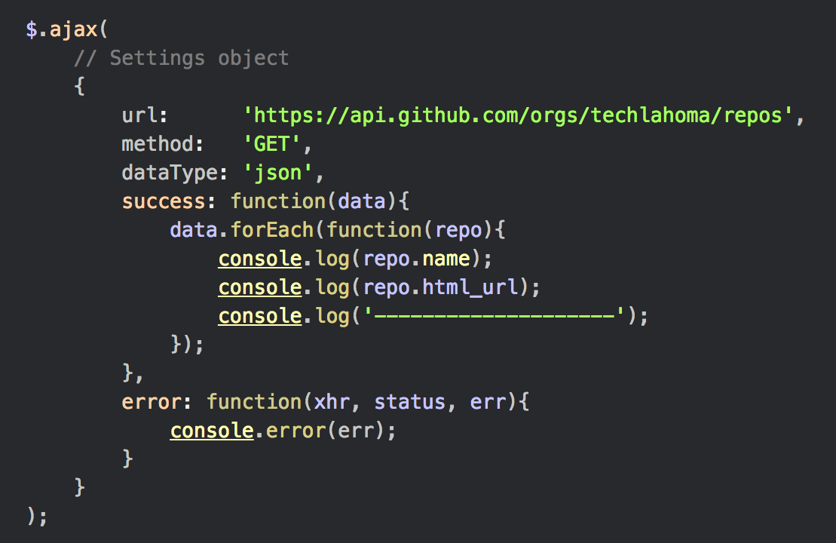
USING $.ajax
First, let's go over an example to illustrate the syntax. Let's get a list of all of the repositories Techlahoma has created on GitHub:

Slide 28
$.ajax settings object
Setting | Use
url | The URL to which we are sending the request
method | HTTP verb we want to use (GET, POST, PUT, DELETE, etc)
dataType | Instructions jQuery on how to parse the response
success | Success handler function
error | Error handling function
contentType | The content type of the request body
data | Data being sent with the request
headers | Object containing key/value pairs of headers to set with the request

Slide 29
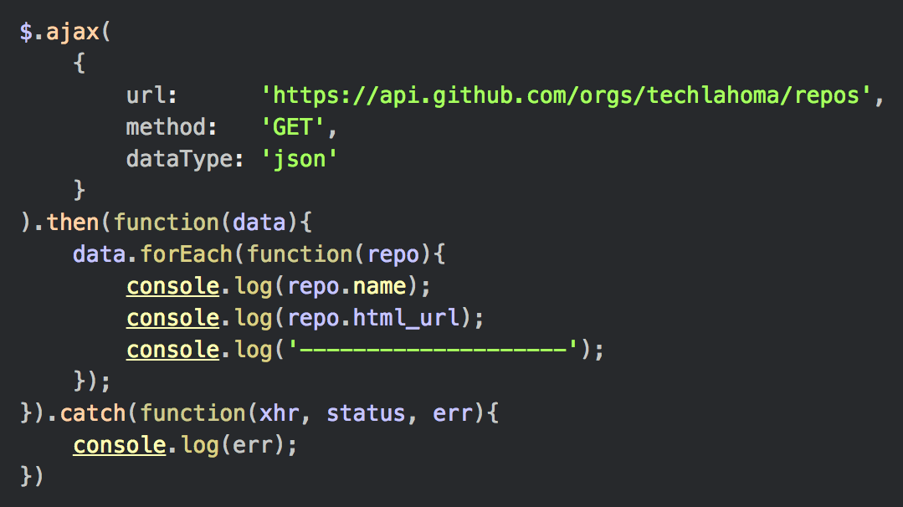
$.ajax promise-like return object
Note the the object returned by $.ajax implements the promise interface, which gives it all of the properties, methods, and behavior of a Promise.
With that in mind, we could also write our example like this:

Slide 30

.done(), .fail(), .always()
The $.ajax method also provides some other methods that can be chained on to the returned object. They include, but are not limited to .done, .fail, and .always.
.done will fire when the request completes successfully, .fail fires on error, and .always fires on success or failure.
Using this interface, we could also write our example like this:
Note: This example is the most common way to use $.ajax, though you should be familiar with the other methods.

Slide 31
Practical examples with semi-live coding
Let’s use the GitHub v3 API to find repositories owned by an organization that contain issues.
Hopefully we can find some issues that have been tagged as beginner-friendly or help wanted.
The goal here is to identify open source repositories that have issues that beginners can contribute to solving.
The tech stack for this experiment:
jQuery.ajax for network requests
Handlebars for template rendering
EventEmitter2 for message passing within our application (PubSub)
Other utilities such as a grid for layouts and a library for giving text contrast against an arbitrary background color (used for GitHub label colors)

